Slide 1
Withdrawing Medication From a Vial
Lesson One
Lori Fusco, Beth Ghioldi, Brittany Mancini

Slide 2
Review Questions
1. Which of the following is the FIRST priority in preventing infections when providing patient care?
a. wearing gloves
b. wearing gown and goggles
c. applying a protective face mask
d. hand washing

Slide 3
Review Questions…
2. The nurse takes Mrs. Smith’s 8:00 am antibiotic into her room. Mrs. Smith asks the nurse what the medication is and why she should take it. The appropriate reply by the nurse is:
a. Tell Mrs. Smith the name of the medication and a description of its desired effect.
b. Advise Mrs. Smith to ask her doctor when he visits her in the morning.
c. Explain to Mrs. Smith that the doctor prescribed the medication because she needs it.
d. Let Mrs. Smith know that you are not familiar with the medication.

Slide 4
Review Questions…
3. When identifying a new patient before administering medications, the nurse asks the patient to state his name. The patient states a name different than the armband. The nurse asks again, and the patient states yet another name. What is the nurse’s next action?
a. Match the patient’s armband to the name on the MAR and administer the medications.
b. Hold the medications and contact the physician.
c. Evaluate the patient’s mental status before administering any further medications.
d. Ask another nurse or family member to identify the patient.

Slide 5
Review Questions…
4. The nurse is preparing to administer a tablet to a patient. The nurse should remove the PO medication from its unit dose package:
a. Outside the door to the patient’s room
b. At the patient’s bedside
c. In the medication room
d. At the medication cart

Slide 6
Answers to Review
1. D Hand washing.
2. A Tell Mrs. Smith the name of the medication and a description of its desired effect.
3. C Evaluate the patient’s mental status before administering any further medications.
B At the patient’s bedside.
How did you do?
Microsoft Clip Art

Slide 7
Parts of a Syringe
Plunger: The part of a syringe that goes inside the barrel and pushes the contents of the syringe out.
Barrel: The cylindrical part of a syringe that holds fluid.
Needle Hub: The hub is at one end of the needle and is the part that attaches to the syringe.

Slide 8
Parts of a Syringe…
Needle: Used to inject liquid into the body tissues.
Shaft: The long slender stem of the needle that is beveled at one end to form a point.
Lumen: The hollow bore of the needle shaft.
Bevel: The sloping point at the sharp end of the needle.

Slide 9
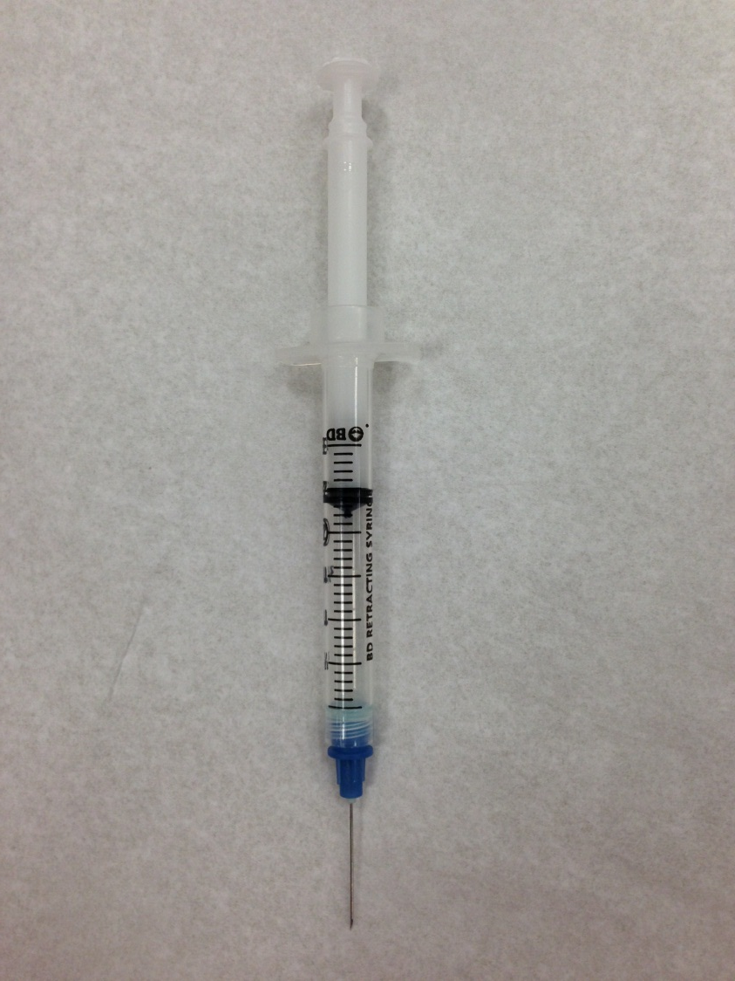
Can you name the parts?
Plunger
Barrel
Needle hub
Needle

Slide 10
How to Withdraw Medication From a Vial
Check the order, gather equipment, and perform hand hygiene.
Remove the cap on the vial that protects the rubber stopper.
Swab the rubber top with alcohol. Allow to dry.

Slide 11
How to Withdraw…
Remove the cap from the needle or blunt cannula.
Touch the plunger at the knob only. Draw back
an equal amount of air into the syringe that is
equal to the specific dose of the medication to
be withdrawn.
Hold the vial on a flat surface. Pierce the rubber
stopper in the center with the needle tip and inject
the measured air into the space above the
solution.

Slide 12
How to Withdraw…
Invert the vial. Keep the tip of the needle or blunt cannula below the fluid level.
Hold the vial in one hand and use the other to withdraw the medication. Touch the plunger at the knob only. Draw up the prescribed amount of medication while holding the syringe vertically and at eye level.

Slide 13
How to Withdraw…
8. If any air bubbles accumulate in the syringe, tap
the barrel of the syringe sharply.
9. After the correct dose is withdrawn, remove the
needle from the vial and carefully replace the cap
over the needle.
10. Check the amount of medication in the syringe
with the medication dose and discard any surplus.
11. Recheck the label with the order. Administer to
the patient.

Slide 14
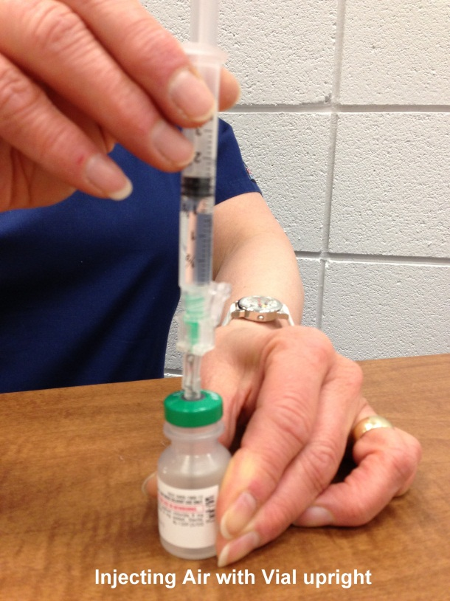
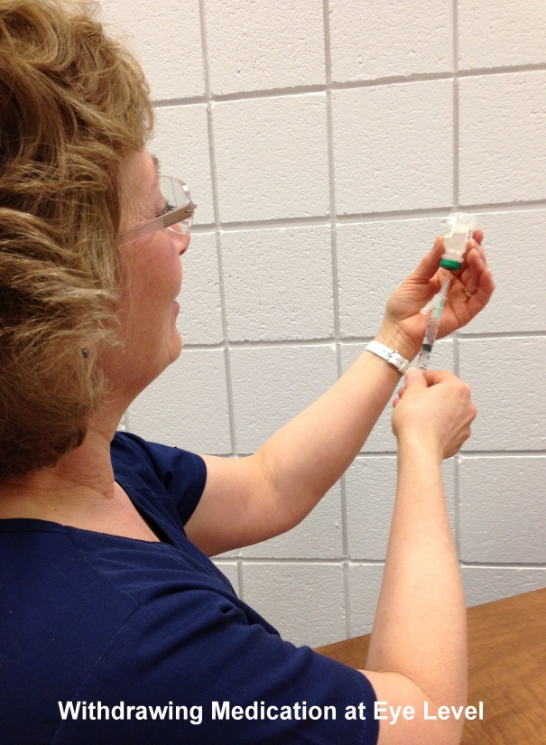
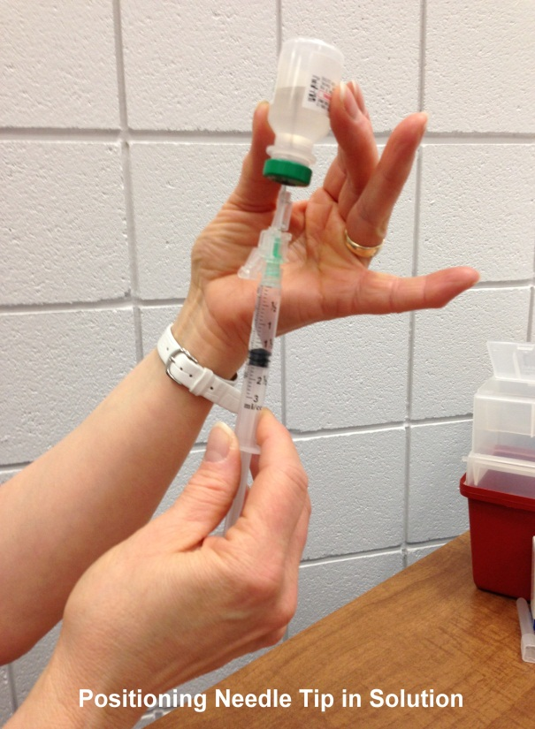
Let’s Review!
Now you’re ready to administer your injection!

Slide 15

Reconstituting Powdered Medication in a Vial
Check the order, gather equipment, and perform hand hygiene.
Remove the cap on the medication vial and diluent vial that protects the self-sealing stoppers.
Swab the vial tops with alcohol and allow to dry.
Microsoft Clip Art

Slide 16
Reconstituting Powdered…
Draw up the appropriate amount of diluent into the syringe.
Insert the needle or blunt cannula through the
center of the stopper on the powdered
medication vial.
Inject the diluent into the powdered medication
vial.
Remove the needle or blunt cannula from the vial and replace the cap.

Slide 17
Reconstituting Powdered...
Gently agitate the vial to mix the powdered medication and diluent completely. DO NOT SHAKE.
Draw up the prescribed amount of medication while holding the syringe vertically and at eye level.
10. After the correct dose is withdrawn, remove the
needle from the vial and carefully replace the cap
over the needle.

Slide 18

Reconstituting Powdered…
11. Check the amount of medication in the syringe
with the medication dose and discard any surplus.
12. Recheck the label with the order. Administer to
patient.
Microsoft Clip Art

Slide 19
Mixing Medications From Two Vials in One Syringe
The following instructions will mix modified and unmodified insulin. This skill is a little tricky at first, but you’ll become more comfortable with time and practice.
Microsoft Clip Art

Slide 20
Mixing Medications…
Check the order, gather equipment, and perform hand hygiene.
Roll and agitate the modified insulin vial to mix.
Remove the caps from the vials and cleanse with alcohol. Allow to dry.
Remove cap from needle. Touch plunger at the knob only. Draw back an amount of air into the syringe that is equal to the dose of modified insulin to be withdrawn.

Slide 21
Mixing Medications…
Hold the modified vial on a flat surface. Pierce the rubber stopper in the center with the needle tip and inject the measured air into the space above the solution. Withdraw the needle.
Draw back an amount of air into the syringe that is
equal to the dose of unmodified insulin to be
withdrawn.

Slide 22
Mixing Medications…
Hold the unmodified vial on a flat surface. Pierce
the rubber stopper in the center with the needle
tip and inject the measured air into the space
above the solution. Keep the needle in the vial.

Slide 23
Mixing Medications…
Invert vial of unmodified insulin. Hold the vial in one
hand and use the other to withdraw the
medication. Touch the plunger at the knob only.
Draw up the prescribed amount of medication
while holding the syringe at eye level and
vertically. Turn the vial over and then remove
needle from vial.

Slide 24
Mixing Medications…
Check that there are no air bubbles in the syringe.
Check the amount of medication in the syringe
with the medication dose and discard any surplus.
11. Recheck the vial label with the order.

Slide 25
Mixing Medications…
12a. Insert the needle into the modified vial and invert
it, taking care not to push the plunger and inject
the medication from the syringe into the vial.
Invert vial of modified insulin. Hold the vial in one
hand and use the other to withdraw the
medication. Touch the plunger at the knob only.

Slide 26
Mixing Medications…
12b. Draw up the prescribed amount of medication
while holding the syringe at eye level and
vertically. Take care to withdraw only the
prescribed amount. Turn the vial over and then
remove needle from vial. Carefully recap the
needle.

Slide 27

Mixing Medications…
Check the amount of medication in the syringe
with the medication dose.
Recheck the vial label with the order. Administer
to patient.
Great Job!
Microsoft Clip Art

Slide 28
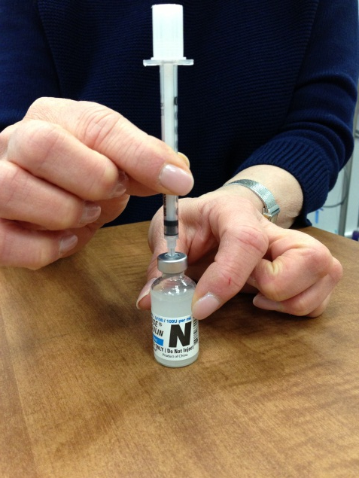
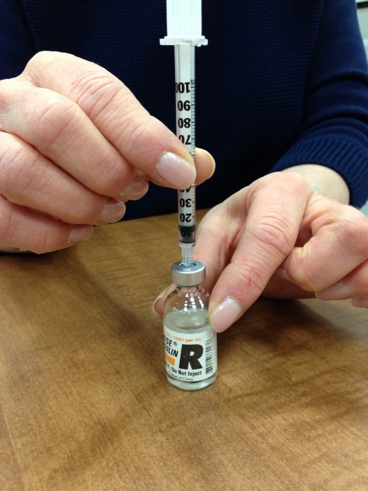
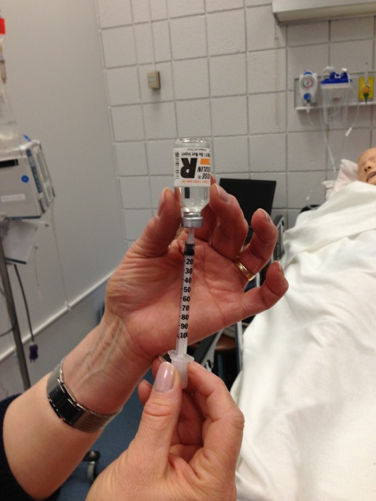
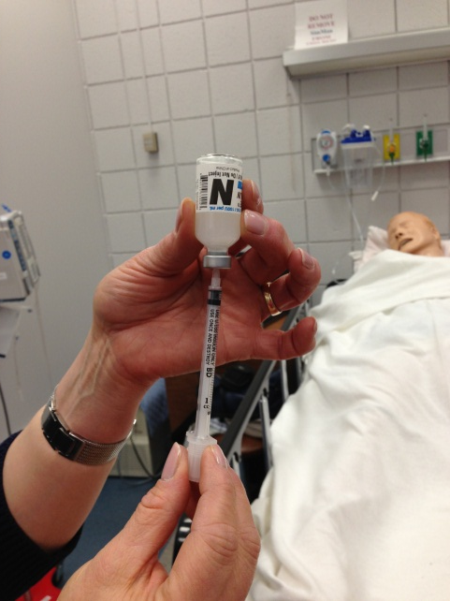
Let’s Review!
You are now ready to administer your insulin injection!

Slide 29
Practice Makes Perfect
Now that you have learned:
Parts of a Syringe
Withdrawing Medication from a Vial
Reconstituting Powdered Medication in a Vial
Mixing Medications from Two Vials in One Syringe
You are encouraged to practice withdrawing medication from a vial on your own. Vials of water and syringes may be purchased at your local pharmacy and/or medical supply store.
Microsoft Clip Art

Slide 30
References
Lynn, P. (3rd). 2011. Taylor’s clinical nursing skills: A
  nursing process approach. New York, NY: Lippincott.

